Slide 1
CSE 442/542– Software Engineering Concepts
Prof. Matthew Hertz Davis 338L/ 645-4736 mhertz@buffalo.edu

Slide 2
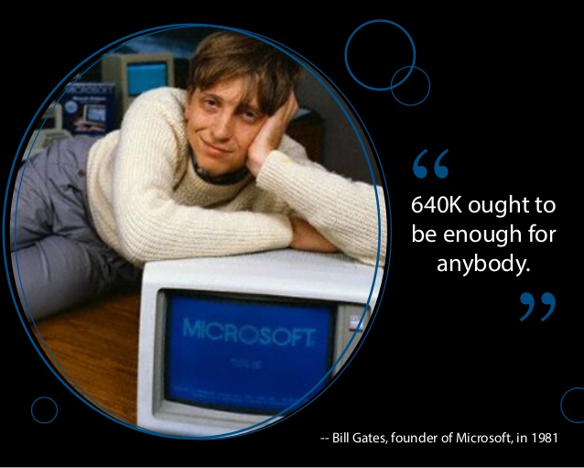
“Adaptable to Chang[e]”

Slide 3
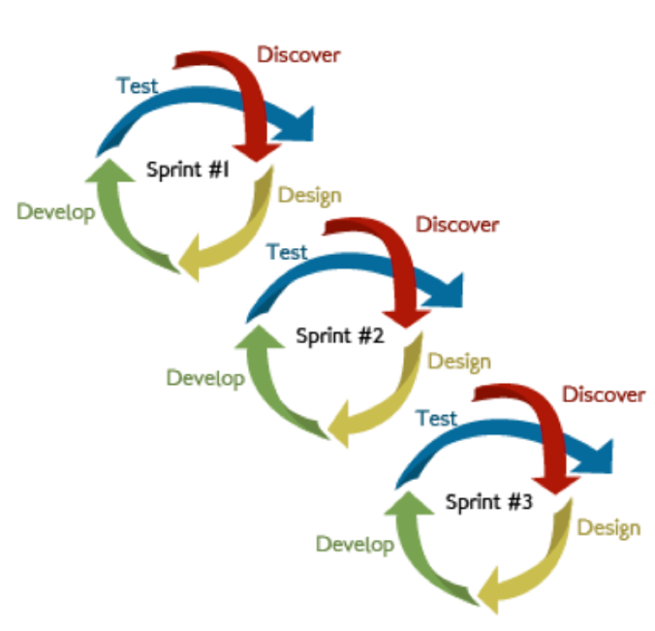
Software Engineering Role
Select long-term management approaches
Software Lifecycle and Project Management

Slide 4
Programming is Important
“Software construction is the central activity… the only activity guaranteed to happen.”
Code is THE main deliverable to customer
Code is unimportant to customers; they do not care
Do care about: GUI, manuals, distribution media, …
Could code be our only focus?

Slide 5
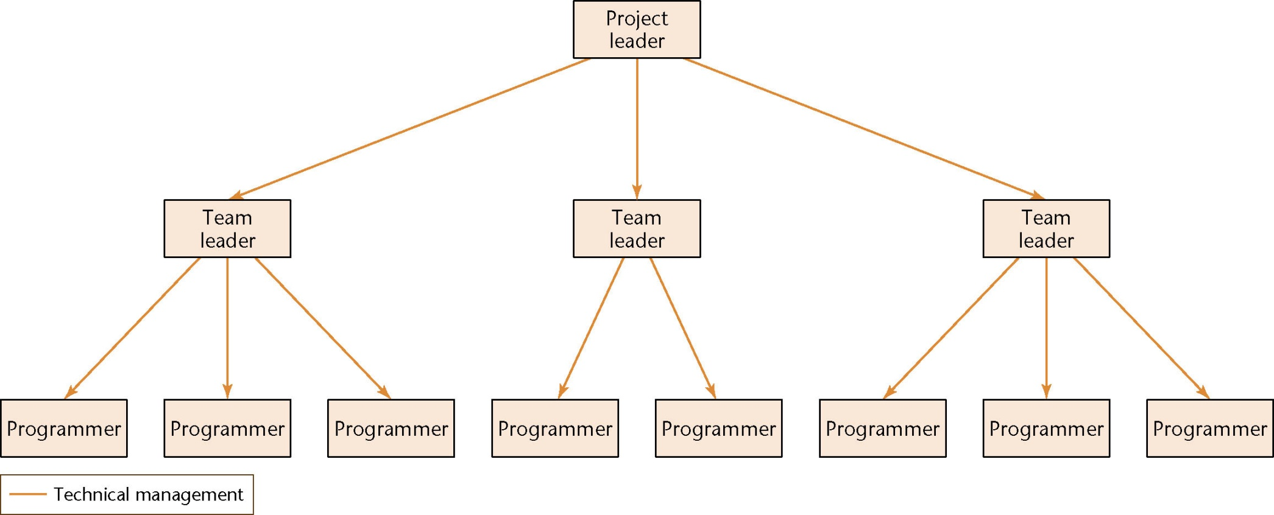
Teams In The Real World
Scale to larger teams of 20 - 120 programmers
Whenever necessary, add more layers

Slide 6
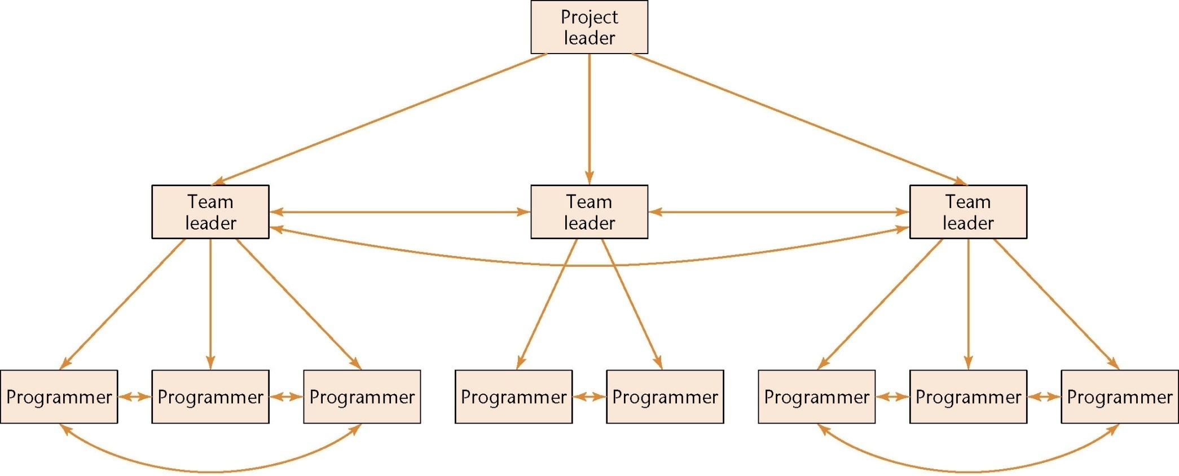
Democracy InAction
Limit politics using teams and group concepts

Slide 7
Democracy InAction
Limit politics using teams and group concepts
Worst of the in-fighting prevented

Slide 8
Democracy InAction
Limit politics using teams and group concepts
Worst of the in-fighting prevented by meetings

Slide 9
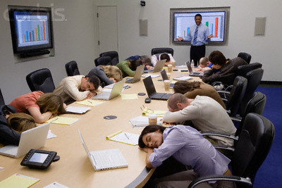
Democracy InAction
Limit politics using teams and group concepts
Worst of the in-fighting prevented by meetings

Slide 10
Synchronize-and-Stabilize
Used by Microsoft (& adapted for open-source)
Teams of 3 – 8 developers (& 3 – 8 testers for Microsoft)
Team owns entire task; responsibility shared equally
Work from specification through implementation
Regular synchronization & testing key to process
Tests that day’s code to report all errors across project

Slide 11

Classroom Development
Always start from scratch
Requirements perfect from start
Work that must be done is clear
Coding begins immediately at start
Projects are trivial jokes for real-world
Longest project last at most 2 months
Ends total mess; cannot reuse code
Would never reuse, anyway

Slide 12
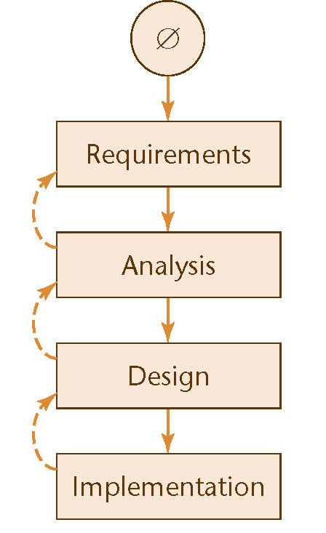
Waterfall Model
Original model of software lifecycle
Outlined steps that must happen
Project finished once shipped to client
Moves software to assembly line
Station-to-station travel of project
Model enables people to specializes
Set of deliverables created over step
Evidence & result of following process
Ends with baseline delivered to client
Contains complete set of documents

Slide 13
Waterfall Model
Original model of software lifecycle
Outlined steps that must happen
Project finished once shipped to client
Moves software to assembly line
Station-to-station travel of project
Model enables people to specializes
Set of deliverables created over step
Evidence & result of following process
Ends with baseline delivered to client
Contains complete set of documents
This means:
a) nobody likes it;
b) nobody can make it work; &
c) everybody can improve it.

Slide 14
Waterfall Model
Assumes project begins as clean slate
Ends once coded; no maintenance planned
Led to other name Big Bang approach
Unlikely ever this clean, especially now
Requirements begins with meetings
Only chance for client to provide input
Working together to define project
Ends with contract specifying result
Once contract signed, client goes away
No further interaction until delivery

Slide 15
Waterfall Model
Analysts use contract to develop ideas
Will create models, schema, business logic
But starts with check of contract
Looking for inconsistencies or ambiguities
Very limited window to flag mistakes
Hands results to the project design team
Design outlines code to be written
Specifies classes & routines needed
Can also include hardware architecture
Must fit models & schema from before
Often gets down to algorithmic level

Slide 16
Waterfall Model
Implementation is for the coders
Start with time to find design problems
Then match design in code written
Only job is to match design given them
Client returns at end to take baseline
Extremely efficient when it works
Revolutionary like Ford’s assembly line
Strengths used due to specialization
With all info, best decisions possible

Slide 17
Waterfall Model
Useful when:
Client knows what they need
Needs can be fully documented & described
Little-to-no interaction sought while developed
Large organization able to keep specialists
Maintenance & updates unimportant/not on the table
Working in a regulated industry (ex. Healthcare, Finance, Military)
Not useful when:
You are developing non-critical products in the 21st century

Slide 18
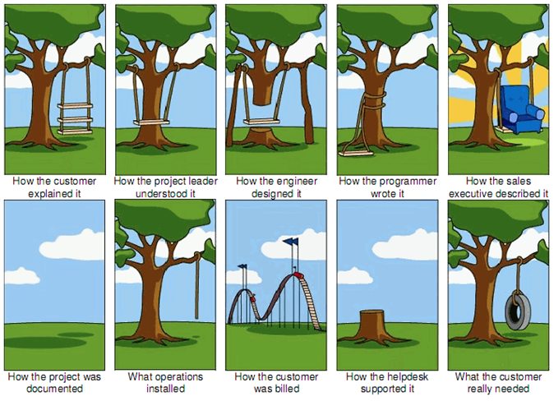
https://www.linkedin.com/pulse/software-its-requirements-stupid-anton-jansen

Slide 19
Moving Target Problem
Requirements may change during development
Changes may be important, but…
…disrupts flow & introduce dependencies
Changes during process causes regression faults
Error (“fault”) occurs in an unrelated portion of project
These changes become major pain to fix
Faults will build up as changes continue
Eventually requires redesign & reimplementation

Slide 20
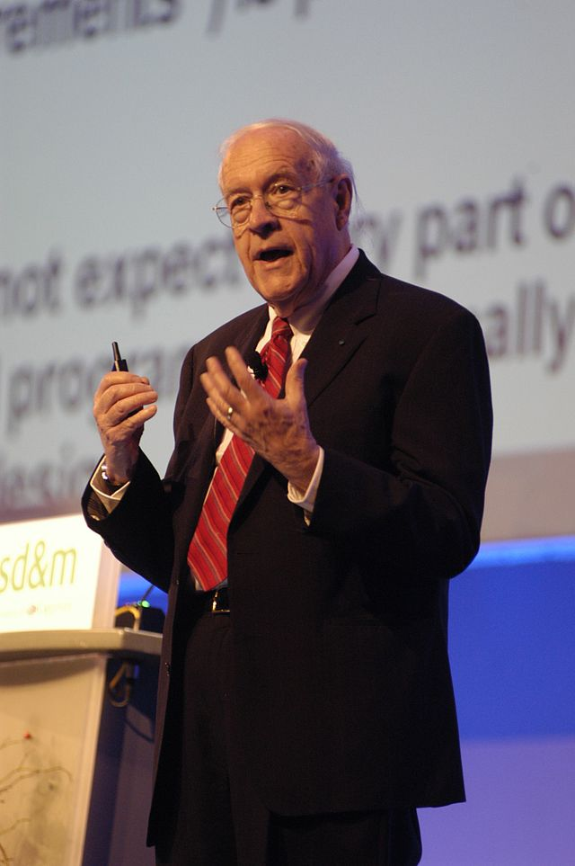
Waterfall Key Problem
Changeability is an essential difficulty with software
Waterfall assumes everything known at start
Fred Brooks

Slide 21
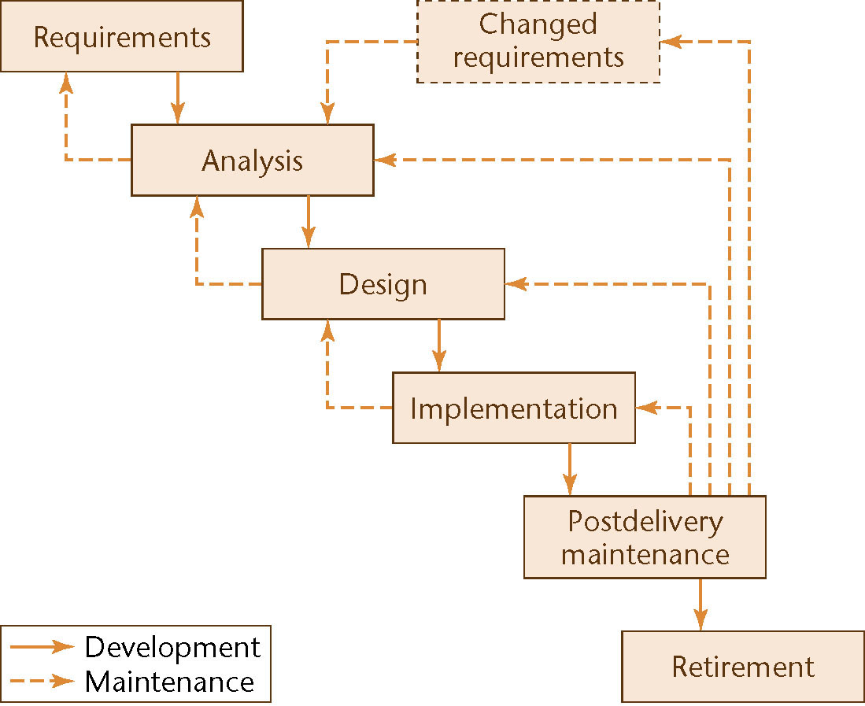
Rapid Prototyping
Create prototype after each step
to check requirements

Slide 22
Rapid Prototyping
Usability and looks are focus for rapid prototype
Provides limited ability for client to provide feedback
Functionality limited to basics (and often faked)
Any restarts take pieces back through full waterfall
Project feasibility unclear, since functionality left to end
Led to creation of VisualBasic and Oracle Forms
Lightweight tools emphasizing GUI functionality
Lousy languages with serious performance issues
Confusion creators, since clients “see” finished product

Slide 23
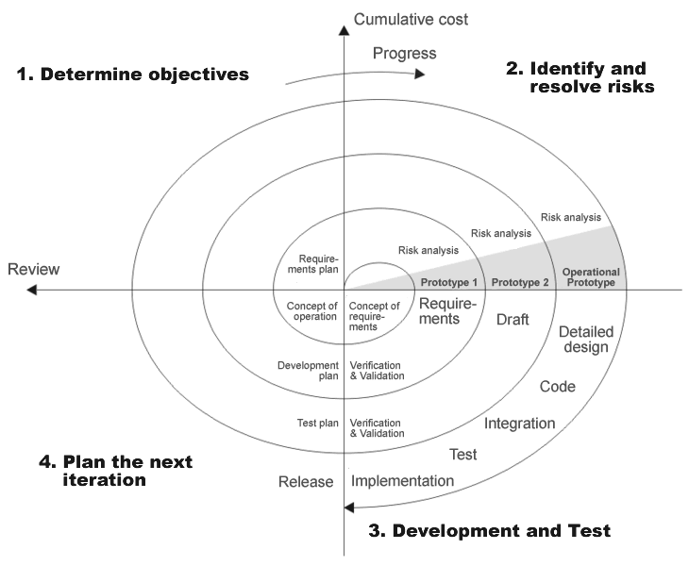
Spiral Lifecycle

Slide 24
Spiral Lifecycle
Useful for projects with unknown levels of risk
Functionality & feasibility key as opposed to looks
Uses waterfall ideas, but more cautious in execution
Each phase ends with estimate for client to review
If client like results and accepts risks, work continues
But okay to kill project when risks deemed too high
Very useful for exploratory or experimental work
Starts small and grows with time and confidence
Also can cause problems, since growth brings own risks

Slide 25
Agile Methods
Builds off of incremental & iterative development
Assumes that the changes inevitable & unpredictable
Planning irrational: only immediate future knowable
Series of short sprints replaces entire waterfall model
Think about the project & select most important tasks
Write acceptance tests to know when tasks complete
Do just enough coding to pass tests (& unit tests)
Design emerges by as code adjusted (refactored)

Slide 26
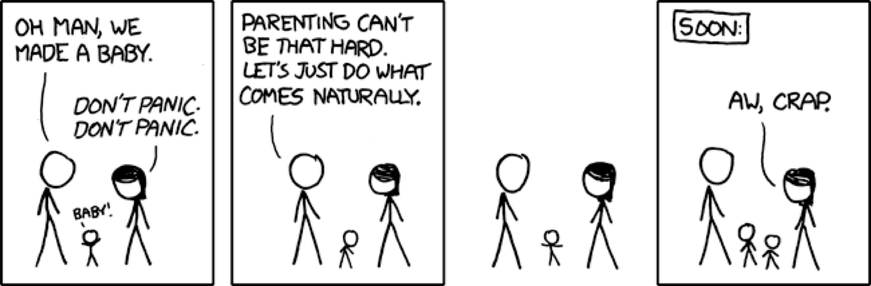
Agile Development
Not engineers, but coders: do what comes naturally

Slide 27
Agile Development
Not engineers, but coders: do what comes naturally
Other options too difficult, so let’s give up entirely!
Not always the best idea, but since we sucked before…

Slide 28
Agile Development
Not engineers, but coders: do what comes naturally
Other options too difficult, so let’s give up entirely!
Not always the best idea, but since we sucked before…

Slide 29
Agile Manifesto
[U]ncovering better ways of developing software... [W]e have come to value:
Individuals and interactions over processes and tools Working software over comprehensive documentation Customer collaboration over contract negotiation Responding to change over following a plan
[T]here is value in the item on the right, we value the items on the left more

Slide 30
Agile Principles
Deliver valuable software early and often
Each time a sprint ends: release running program
Keep sprints short: 2 – 6 weeks standard practice
Welcome changing requirements
Even late in the development process
Standardize on simple, cheap requirement practice
Few requirements per sprint, since sprints short
Keep & update backlog of requirements for later

Slide 31
Agile Principles (cont.)
We follow these principles:
Business people & developers must work together daily...
Build projects around motivated individuals
Give them the environment and support they need
Trust them to get the job done. Within development team embed product owner Eliminate other specializations* creating separations Limit management & trust what coders do naturally

Slide 32
Agile Principles (cont.)
We follow these principles:
Communicate face-to-face
Written over long weekend: February 11-13, 2001
Notes:
Don’t get too attached: this was 9 months before Harry Potter movie was released

Slide 33

Agile Principles (cont.)
We follow these principles:
Communicate face-to-face
Written over long weekend: February 11-13, 2001
Notes:
Don’t get too attached: this was 9 months before Harry Potter movie was released

Slide 34
Agile Principles (cont.)
We follow these principles:
Working software is … primary measure of progress
Rather a complete waterfall, jumps into development Documentation not valued: code is real deliverable
Agile processes promote sustainable development
[M]aintain a constant pace indefinitely
No overtime at crunch time
Continuous attention to technical excellence & good design enhances agility
Developers always able to refactor code to improve it

Slide 35
Agile Principles (cont.)
We follow these principles:
Simplicity -- the art of maximizing the amount of work not done -- is essential
“You Ain’t Gonna Need It” important to keep in mind
The best architectures, requirements, and designs emerge from self-organizing teams
Democratic teams (egoless coders) relied upon

Slide 36
Agile Principles (cont.)
We follow these principles:
At regular intervals, the team reflects on how to become more effective, then tunes and adjusts its behavior accordingly
Velocity tracked & used to improve processes

Slide 37
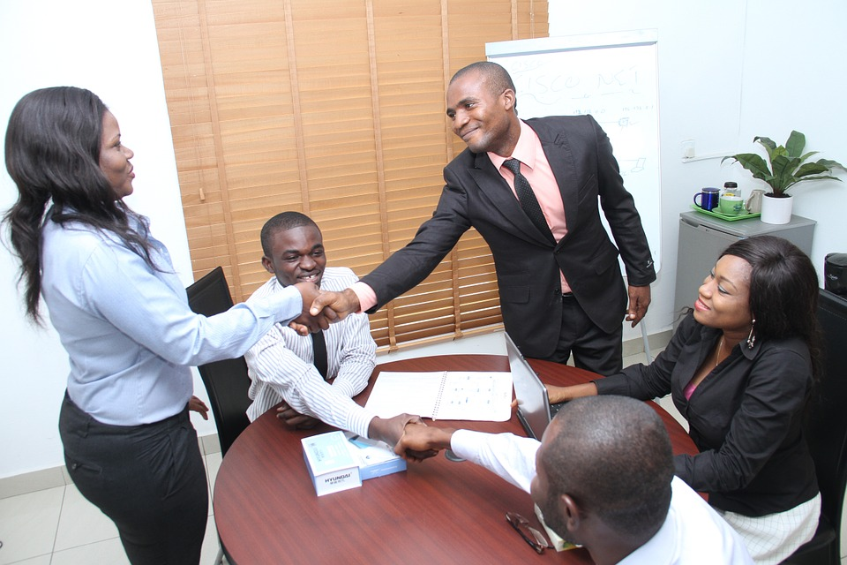
Agile Principles (cont.)
[T]eam reflects then tunes and adjusts accordingly
Most signatories ran consulting companies
Notes:
Picture is not of signatories, but is stock image entered into Public Domain by adabara. Original available at: https://pixabay.com/en/colleagues-seminar-presentation-437024/

Slide 38
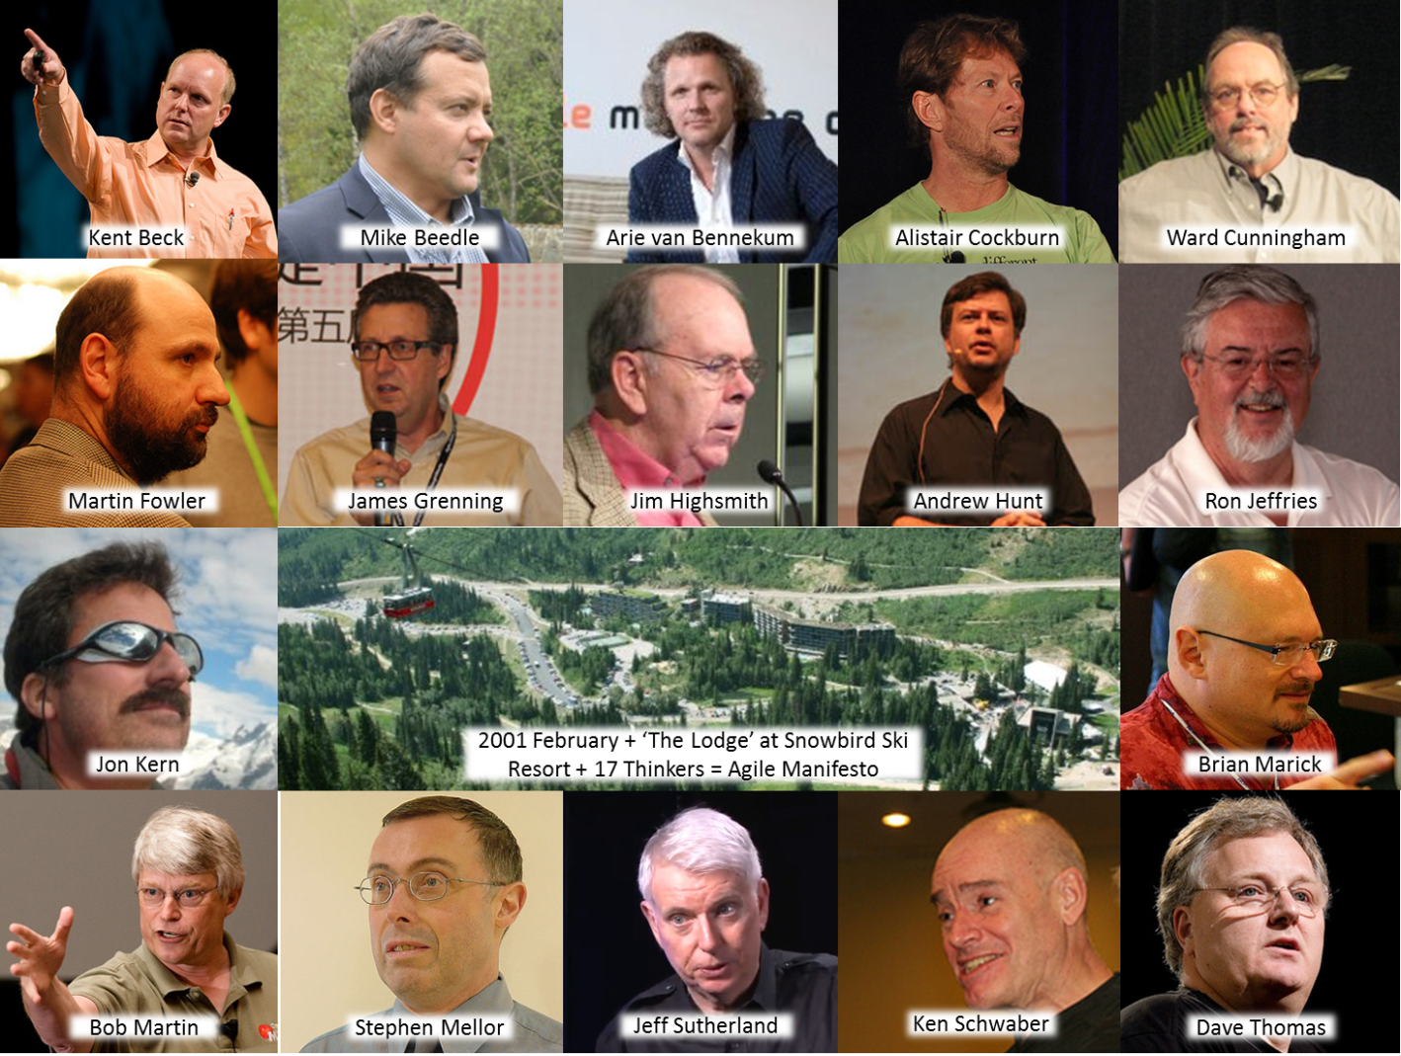
Agile Principles (cont.)
Most signatories ran consulting companies
Notes:
These are actual authors (and site!) of original Agile Manifesto

Slide 39
Make Agile Real: Scrum
User Stories
Lightweight approach to write & gather requirements
Have customer tell story of what they want & need
Write what comes our down without getting technical
Help YAGNI: who wants what & why do they need it?
“As a customer, I want to see the details of each piece of equipment before I add it to my cart so I know if it will be worth buying”

Slide 40
Make Agile Real: Scrum
Tasks
Breaks down stories into technical requirements
Helps focus activities by making story into concrete work
Details needed, by prevents overwhelming customer
Host a database of equipment information
Assign equipment unique IDs embedded on web pages
Write stored procedures taking in unique IDs
Display query results to the user

Slide 41
Sprints in Scrum
Deliver working code at fixed intervals
Creates constant, sustainable, pace for project
Usually 1-4 weeks depending on company needs
Several tasks occur at end of every sprint
Demo the software and/or release the update
Have all-team meeting to discuss project direction
Make adjustments to “become more effective”

Slide 42
Scrum Teams: Co-Location
Team member meet face-to-face often
Start each day with stand-up meeting in many cases
Communicate constantly throughout day
Nobody “owns” code, so important to avoid conflicts
Documentation not valued & often easier to talk
Pair programming big (overlooked) feature of Agile

Slide 43
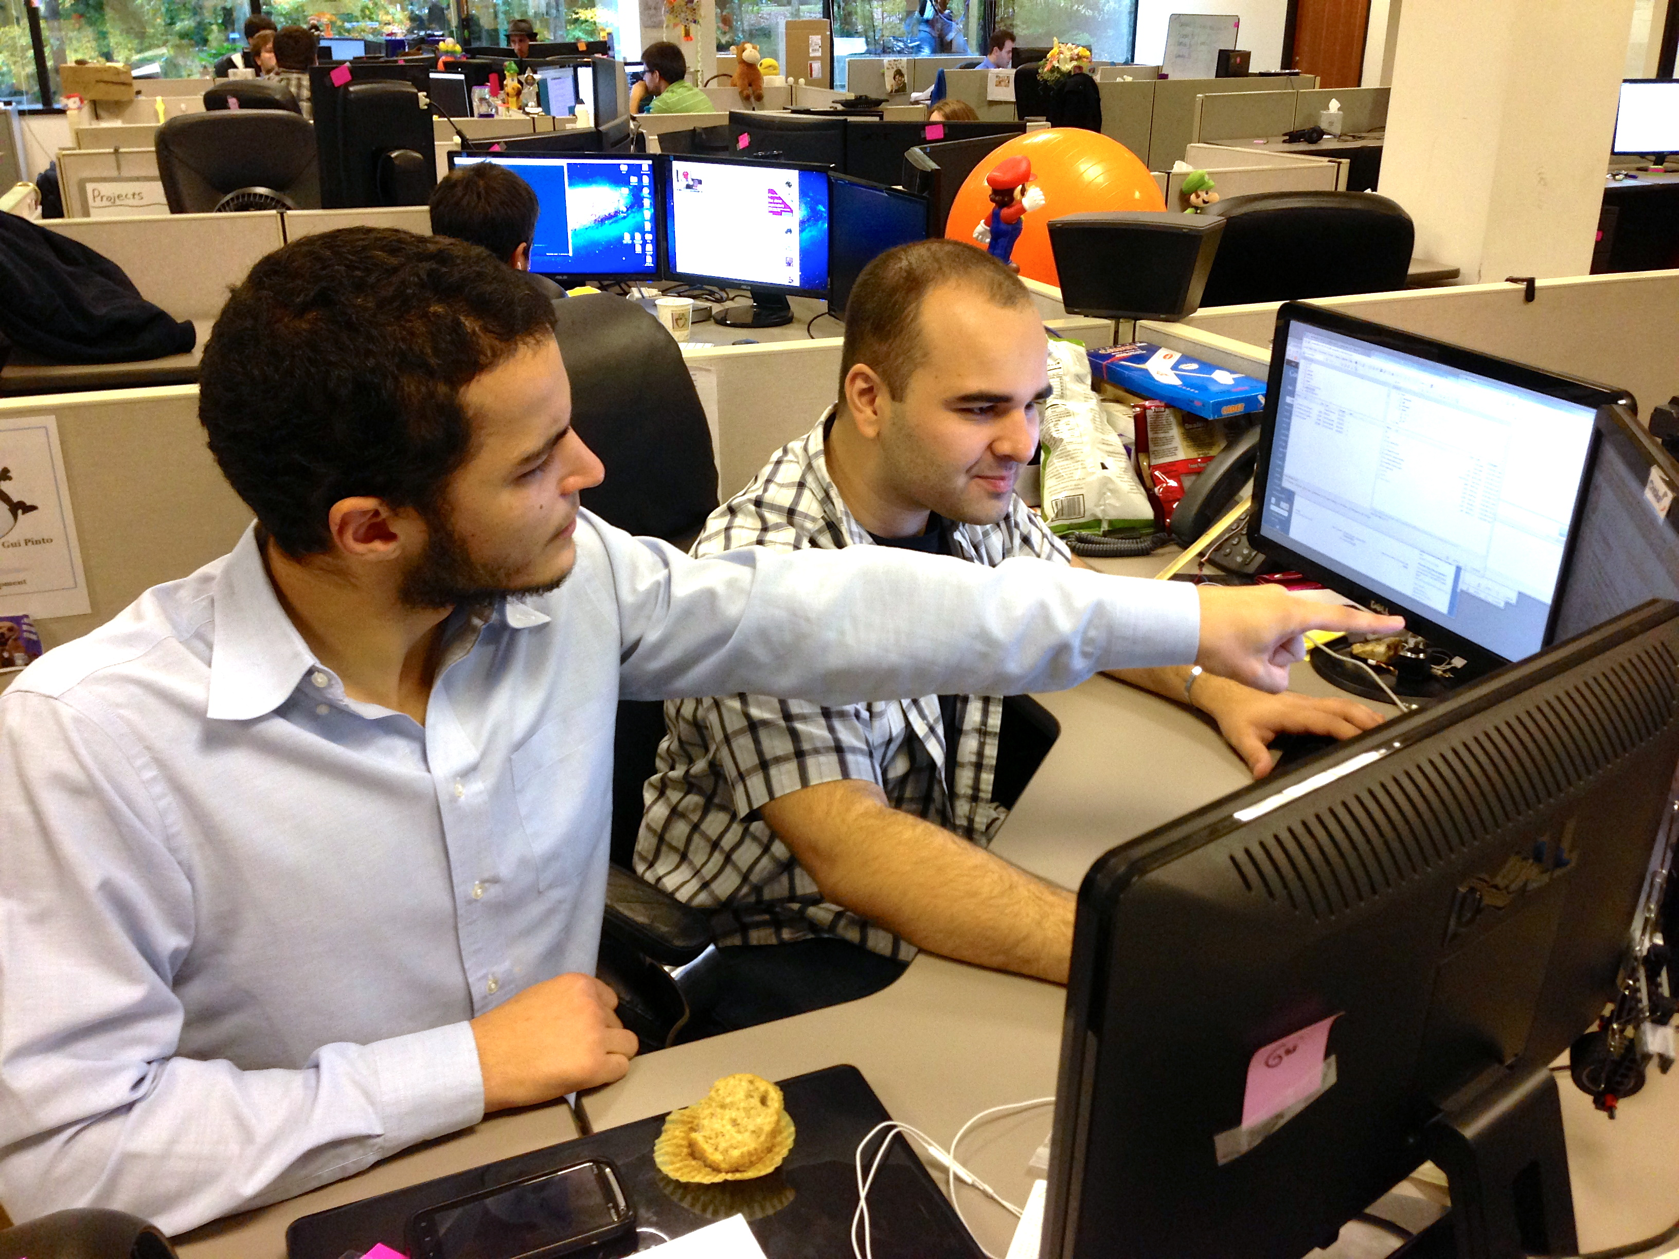
Scrum: Pair Programming

Slide 44
Scrum Teams: Co-Location
Team member meet face-to-face often
Start each day with stand-up meeting in many cases
Communicate constantly throughout day
Nobody “owns” code, so important to avoid conflicts
Documentation not valued & often easier to talk
Pair programming big (overlooked) feature of Agile
All these meetings include additional costs
No remote employees allowed at some companies
Not just small firms: Google requires physical presence
Notes:
Story about Google’s ban: http://scottberkun.com/2014/famous-programmer-leaves-google-because-of-remote-work-ban/

Slide 45
Scrum Board
Displays project state at current moment in time
Tasks displayed in one of several possible columns:
Backlogged
In progress
Testing
Complete
Tasks will be moved & adjusted as they progress
Names not standardized, so use lingo of team
Co-location valued: actual board is ideal goal

Slide 46
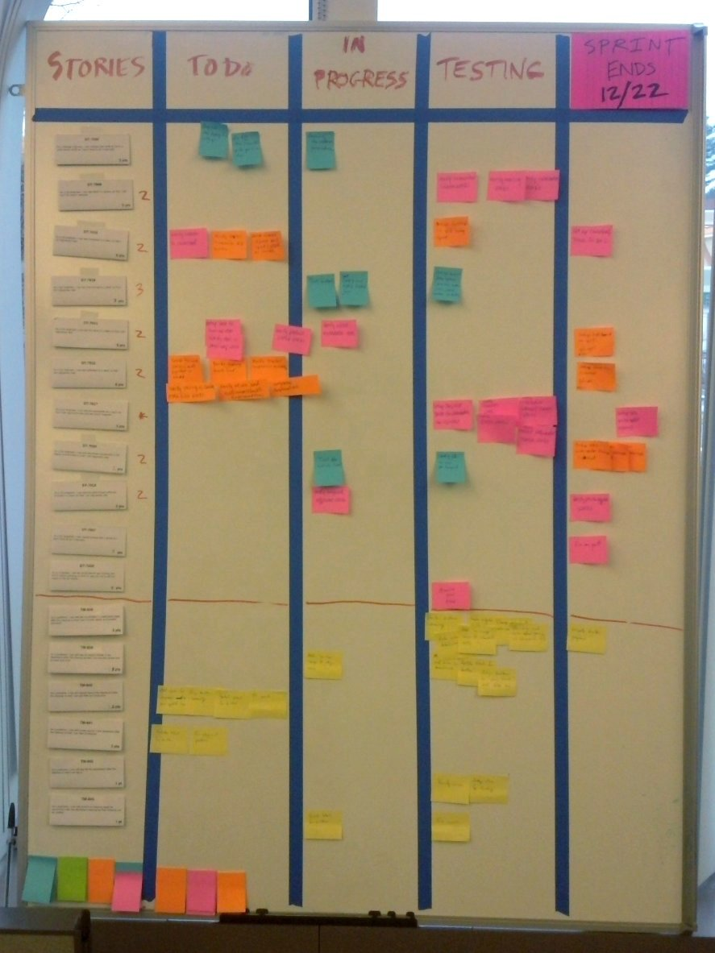
Scrum Board

Slide 47
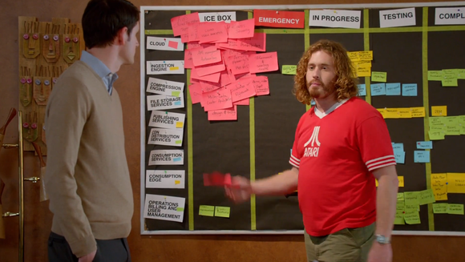
Scrum board
Notes:
From Silicon Valley

Slide 48
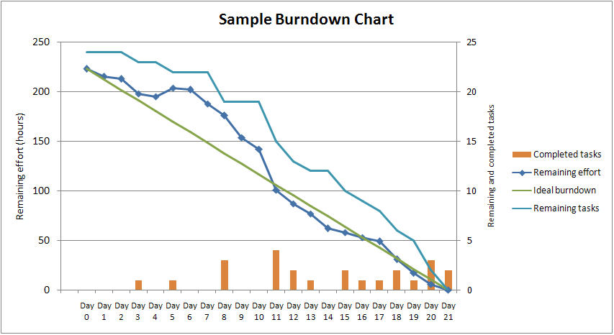
Scrum Board

Slide 49
Scenario Revisited
Gather requirements
Customer: “This is what I want…”
Write & deliver code
Customer: “Okay, but it would be cool if…”
Add and remove from backlog of user stories
At start of sprint, choose stories to implement
Write & deliver code
Customer: “This is better, but now I want…”
Repeat until customer happy

Slide 50
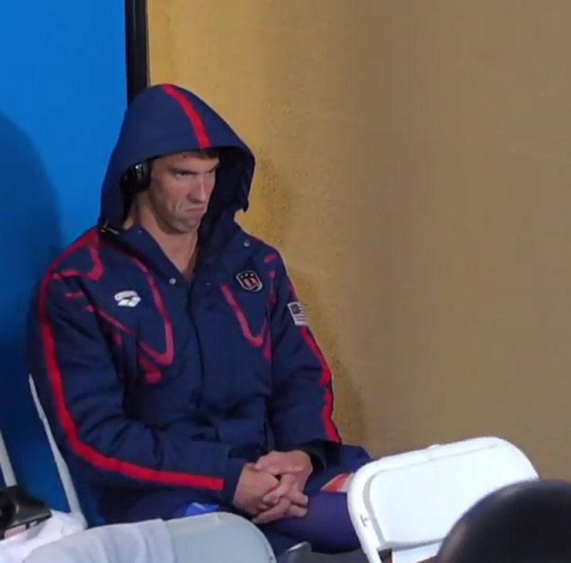
Scenario Revisited
Gather requirements
Customer: “This is what I want…”
Write & deliver code
Customer: “Okay, but it would be cool if…”
Add and remove from backlog of user stories
At start of sprint, choose stories to implement
Write & deliver code
Customer: “This is better, but now I want…”
Repeat until customer happy

Slide 51
Scenario Revisited
Gather requirements
Customer: “This is what I want…”
Write & deliver code
Customer: “Okay, but it would be cool if…”
Add and remove from backlog of user stories
At start of sprint, choose stories to implement
Write & deliver code
Customer: “This is better, but now I want…”
Repeat until customer happy satisfied

Slide 52
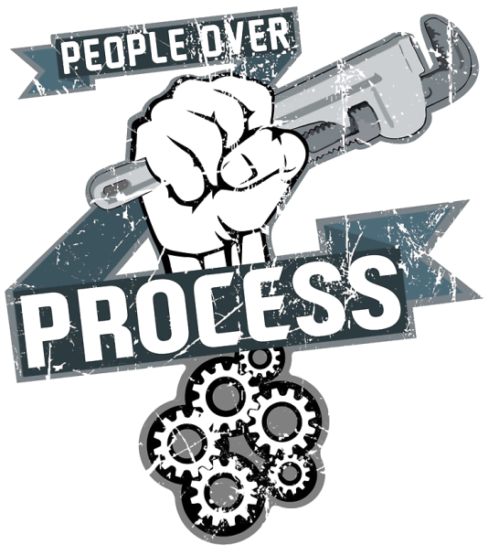
Scrum In Practice
Modified to fit needs & ability of company
Finding identical implementation in two shops is rare
In keeping with Agile Manifesto: not a bad thing

Slide 53
Scrum This Course
Co-location (attendance) mandatory in-class
Can be fired (fail) if you become issue for rest of team
Use tools to maximize other communication
Must create & maintain repo on GitHub (can be private)
Store backlog of stories on GitHub & tag releases
Use & assign tasks to track work done by each member
Useful to earn score on “onboarding” grade in sprint
Slack channel also encouraged for use outside of class
Practice estimating (& measuring) time for each task
Will become important later; better to start now

Slide 54
Scrum This Course
Not a business, so must tweak process
No daily stand-ups
Not holding to 40 hour work week
No budget for tools or training (except the class 😅)
First & last sprint take 2 weeks; others 1 week
Each deadline is class start on that Thursday
Demo executable on clients machine
(Other tasks needed to support educational goals)

Slide 55
For Next Lecture
Split into teams of 3 or 4 before leaving today
Submit names of students & team before you go
Sign up for Piazza & GitHub to be ready for project
Will be going over basics & starting project on Thursday
Will have 2 projects ready; groups can also propose ideas
Notes:
Handout door codes before dismissal

